Slide 1

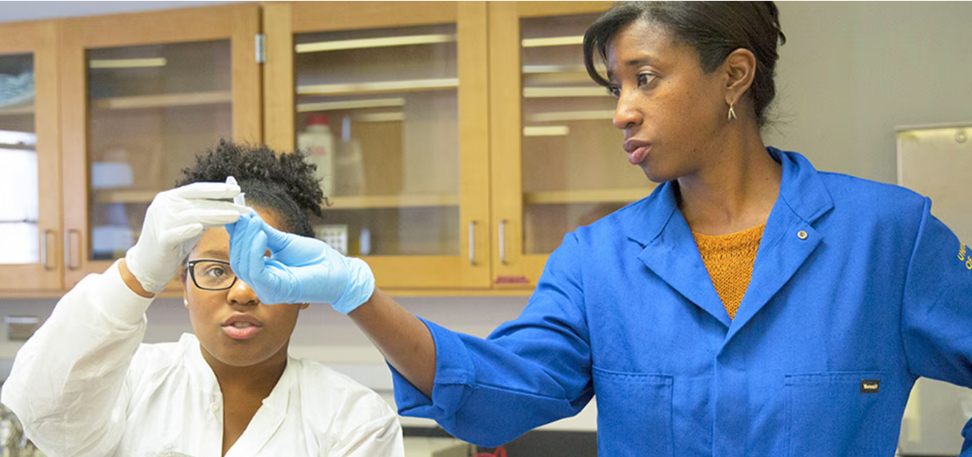
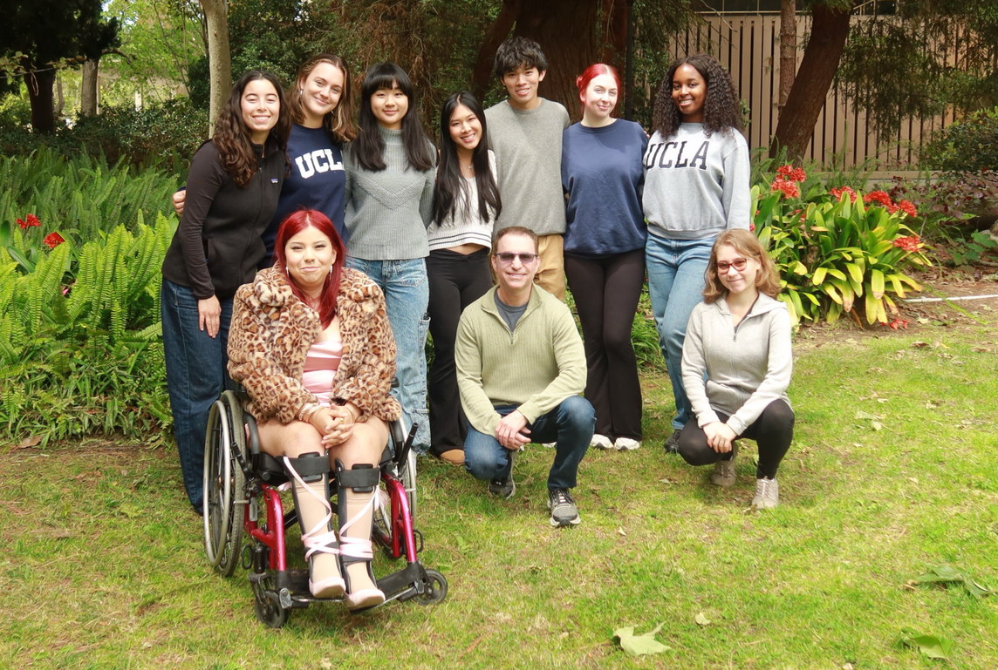
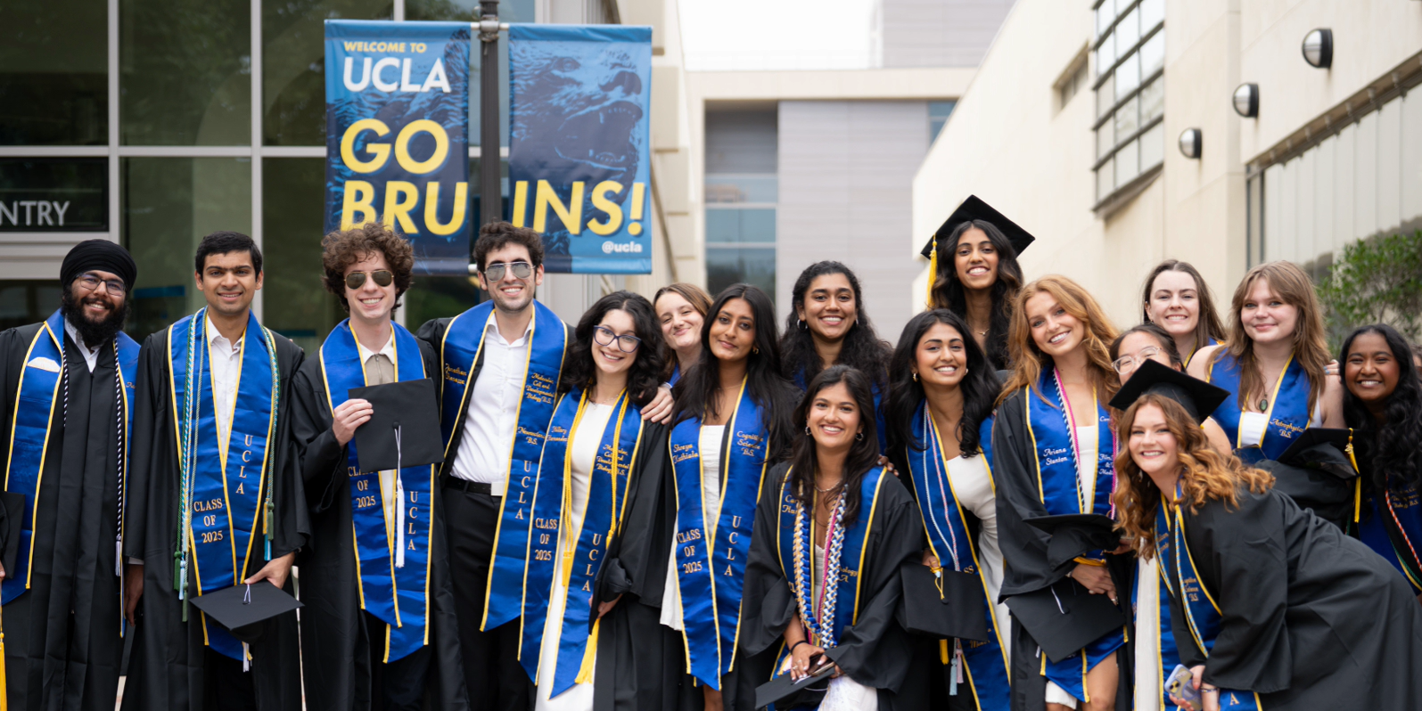
UCLA New Student Orientation:
Life Science Major Advising
Welcome, Bruins! We’re so glad you’re here!
Notes:
Please see instructions for enabling closed captions in Google slides for accessibility purposes.

Slide 2
Land Acknowledgement
UCLA Life Sciences acknowledge the Gabrielino/Tongva peoples as the traditional land caretakers of Tovaangar (the Los Angeles basin and So. Channel Islands). As a land grant institution, we pay our respects to the Honuukvetam (Ancestors), ‘Ahiihirom (Elders) and ‘Eyoohiinkem (our relatives/relations) past, present, and emerging.

Slide 3

Agenda
Life Sciences Core (major preparation courses)
Pre-Health
Research
Major-Specific Information
Career Planning
Fall Enrollment Recommendations
Copy of Presentation
Notes:
Q.R. leads to Google Drive, viewable PDF version of presentation. The link/QR code will remain the same regardless, but the linked copy can still be updated as needed by Sierra. Thank you!

Slide 4
Life Sciences Core
Major Preparation Courses (Lower-Division)

Slide 5
Life Sciences Core Curriculum
(Major Prep.) Overview
Common curriculum to prepare students for a variety of disciplines/majors in the life sciences.
Majority of coursework during your first 2 years at UCLA (~ 2 or 3 courses per quarter).
Courses taught by faculty from diverse life science departments, exposing you to different disciplines.
Aligns with Pre-Health requisites.
Students must take each course for a letter grade and earn a C- or better.
  Note: Physiological Science majors must complete major preparation courses with a C or better.

Slide 6
Life Sciences Core Curriculum
(Major Prep.) Requirements
Biology (1 series)
Calculus (1 series)
Chemistry (1 series)
Statistics (1 course)*
Physics (1 series)

Slide 7
Life Science/Biology Series
All four courses required.
LIFESCI 7A - Cell & Molecular Bio.
LIFESCI 7B - Genetics Evolution & Ecology
LIFESCI 7C - Physiology & Human Bio.
LIFESCI 7L - Intro. to Lab. & Scientific Methods

Slide 8
Calculus Series
Choose 1 Calculus series:
Math for Life Scientists: LIFESCI 30A and LIFESCI 30B
Calculus for Life Scientists: MATH 3A, MATH 3B, MATH 3C *** Note: Not allowed for Comp. Biology.
Pure Calculus: MATH 31A, MATH 31B, MATH 32A***
***Math Diagnostic Test required; AP/IB credit may apply.

Slide 9
Calculus & AP Credit
A.B. Exam:
  5: credit for MATH 31A or 3A → enroll in MATH 3B or 31B
  4: no credit, enroll in LIFESCI 30A, MATH 3A, or MATH 31A
B.C. Exam:
  5: credit for MATH 3B/31B → enroll in MATH 3C or 32A.
  4: credit for MATH 31A or 3A → enroll in MATH 3B or 31B
Note: AP credit does NOT count toward Pre-Health calculus reqs.

Slide 10
Calculus Diagnostic Test
UCLA offers a math diagnostic test which is required to enroll in the Math 3A/3B/3C or Math 31A/31B/32A series.
  80% or above = placed in MATH 3A or MATH 31A
  60-80% required to enroll in MATH 31AL
  30-60% required to enroll in MATH 1 before taking series
Students may have AP/IB credit that can be counted toward these series- information on next slide.

Slide 11
Chemistry Series Options
Choose 1 Chemistry series:
Life Science Series: CHEM 14A (or CHEM 14AE), CHEM 14B (or CHEM 14BE), CHEM 14BL*, CHEM 14C, CHEM 14D
Physical Science Series: CHEM 20A, CHEM 20B, CHEM 20L, CHEM 30A, CHEM 30AL, CHEM 30B
*CHEM 14BL is NOT required for Comp. Bio. Enrollment restrictions apply.
**CHEM 14CL/CHEM 30BL is often required for pre-health professional schools and occasionally graduate schools. Enrollment restrictions apply.
Notes:
Both Chemistry series required Chemistry Diagnostic exam which should have been completed prior to orientation. First-year admitted students must complete the exam before 7/1/26.

Slide 12
Statistics Course*
Computational Biology: STATS 13, LIFESCI 40, or STATS 10
EEB Majors: STATS 13 or LIFESCI 40
MIMG Majors: STATS 13 or LIFESCI 40
Neuroscience Majors: STATS 13, STATS 10 (MATH 31A, 31B, 32A calculus series), or LIFESCI 40 (LIFESCI 30A/B calculus series)
*Statistics is NOT required for MCDB or Phy Sci majors.

Slide 13
Physics Series
Choose 1 Physics series:
Physics for Life Science Majors: PHYSICS 5A, PHYSICS 5B, PHYSICS 5C
Physics for Scientists & Engineers: PHYSICS 1A, PHYSICS 1B, PHYSICS 1C, PHYSICS 4AL, PHYSICS 4BL
Requires calculus completion to start series.
**For non pre-health EEB students only : students can take EEB 15: Physics for Biologist to fulfill physics requirements.

Slide 14
Pre-Health Planning

Slide 15
What is “Pre-Health”?
“Pre-Health” is an umbrella term, referring to the pathways that prepare students for careers in healthcare professions (i.e. medicine, nursing, optometry, pharmacy, dental, physical therapy, veterinary fields, etc.).
UCLA has several Pre-Health services and Pre-Health resources for students.
Pre-Health students MUST consult individual professional schools in addition to UCLA general guidance as professional schools can theoretically change their individual admission requirements at any time.

Slide 16
Pre-Health Requirements
  Pre-Health students MUST consult individual health professional schools in addition to this general guidance.
  Students applying to health professional programs such as medical school will have additional Pre-Health requisite requirements needed for application. Many of these requirements will align with the Life Science Core.
  AP coursework does not typically apply toward Pre-Health/Pre-Med requirements. Only community college or four-year institution coursework is considered “college-level” for Pre-Health purposes.
  Major-specific enrollment restrictions may apply at UCLA (i.e. CHEM 14BL & 14CL), even for Pre-Health students.
Notes:
Pre-Health “Plan Your Courses” website with Pre-Health requirements worksheet
Some Chem courses are not required by LS majors. This will create enrollment restrictions for even pre-health students

Slide 17
Key Pre-Health Requirements
3 Writing (“W”), English (ENGL), and/or Comparative Literature (COM LIT) courses
3 courses of Math/Calculus and Statistics. This may be covered by Life Science Core requirements depending on your major.
Biology Series with Lab (“1 year of Biology” covered by Life Science Core)
Chemistry Series with Labs (i.e. Life Science Core series with CHEM 14BL/20AL + 30AL -and- additional Organic Chem. lab 14CL or 30BL).
Physics Series with Lab (covered by Life Science Core)
Notes:
Some Chem courses are not required by LS majors. This will create enrollment restrictions for even pre-health students .

Slide 18
Additional Requirements by Field
Students should please review Additional Requirements by Field
Example: Recommended for Medical School
  PSYCH 10 (Psychology) - MCAT preparation
  SOCIOL 01 (Sociology) - MCAT preparation
  Spanish is recommended for competitiveness, especially if practicing in California.
Notes:
Some Chem courses are not required by LS majors. This will create enrollment restrictions for even pre-health students .

Slide 19
Pre-Health Course Planning Support
  Contact Life Science major advisors and/or UCLA College Advisors for Pre-Health course planning.
  UCLA has a Pre-Health Requirements Worksheet to support students with general planning.
  Students MUST go to individual professional schools to verify their individual/unique requirements.
  Note: enrollment restrictions may apply (i.e. CHEM 14BL & 14CL), even for pre-health students.
Notes:
Some Chem courses are not required by LS majors. This will create enrollment restrictions for even pre-health students

Slide 20
Pre-Health Application & Career Planning
  Contact Pre-Health career advisors in drop-in advising or scheduled appointments.
  UCLA has various Pre-Health services including online resources and workshops/events.

Slide 21
Summer Pre-Health Orientation
Career Center Services & Resources
Join the UCLA Career Center to learn about services and resources that can support your pre-health journey.
There will be two summer sessions—attend whichever one works best for you to learn more!
July Session: Friday, July 31 | 10–11 AM (PT) | Zoom
(Register for the July 31 session)
September Session: Thursday, September 3 | 12–1 PM (PT) | Zoom
(Register for the Sept 3 session)

Slide 22
Undergraduate Research

Slide 23
Getting Involved In Undergraduate Research
Biomedical Research Minor
  Introductory course required to apply - BMD RES 5HA, BMD RES 10H, HNRS 70A
Undergraduate Research Center - Sciences
Consult with your major advisor for major-specific information (i.e. MIMG’s Undergraduate Research Guide).

Slide 24
Major-Specific Information

Slide 25
Computational and Systems Biology (CaSB)
Interdepartmental Program
Comp. Bio Major
Mathematical Biology Minor
Systems Biology Minor

Slide 26
Computational Biology (Comp Bio) Major
Computational and Systems Biology (CaSB) is an interdisciplinary field that trains students to solve fundamental and applied biological problems by combining the sciences, mathematics, and computing.
Students learn to apply quantitative and computational approaches to solve a vast array of biological questions, such as how cells process information, which genes influence disease risk, what determines rates of tumor growth, and which factors drive biodiversity.

Slide 27
Computational Biology (Comp Bio) Major
Research Driven Major
Core Courses:
  Capstone(Research) requirement
  Core Curriculum Research intensive
  Three Different Track Elective Options for Students to choose from.
Career highlights
  Biotech
  Masters and Doctoral Programs
  Data Science
  Among many other career pathways

Slide 28

EEB Department
Biology, Ecology, Behavior, and Evolution (EBE), and Marine Biology Majors
Notes:
“EEB offers three (3) different majors: Biology, Ecology, Behavior, and Evolution (EBE), and Marine Biology
And two (2) minors : Conservation Biology, Evolutionary Medicine
The focus of the EEB department is to explore the natural world, including the study of non-human behavior (animals and plants), biodiversity, ecology, conservation biology, evolution (including evolutionary medicine), marine biology, plant biology, paleobiology, physiology, and tropical biology, among other areas of interest. Although the EEB majors do not focus on human biology or physiology, many of our students pursue careers in the health sciences, including medicine, dentistry, pharmacy, veterinary medicine, and all other career paths.”

Slide 29
Biology
Biology is a flexible major that allows students to explore diverse areas of the life sciences while building a strong foundation in biology, chemistry, physics, and mathematics. Students can tailor their coursework to their interests, from genetics and evolution to ecology, physiology, and molecular biology. This major is an excellent choice for students seeking a broad understanding of biological science and is particularly popular among those preparing for careers in healthcare, research, biotechnology, and other science-related fields.
Students in this major are housed under Ecology & Evolutionary Biology so will have priority, first, and potentially second pass access to EE BIOL courses and will have to confer with the class notes for any non-EE BIOL courses.
[ADD PHOTOS, VISUALS AS DESIRED]

Slide 30
Ecology, Behavior, & Evolution (EBE)
EBE is a major that explores how living organisms interact with one another and their environments, why they behave the way they do, and how species change over time. Students gain a deeper understanding of the natural world while developing skills in scientific inquiry and research through their culminating research experience (which includes the Field Biology Quarter*). The EBE major is an excellent choice for students interested in wildlife, conservation, environmental science, research, veterinary medicine, or pursuing advanced study in the biological sciences.
*Students in this major must complete a culminating research experience. More information can be found on our EEB website.

Slide 31
Marine Biology
The Marine Biology major focuses on understanding marine organisms, their
environments, and the processes that shape ocean ecosystems. Students combine classroom learning with hands-on field research, including our immersive Marine Biology Quarter* preparing them for careers in marine science, conservation, research, and environmental management.
*Students in this major must complete a culminating research experience. More information can be found on our EEB website.

Slide 32
EEB LISTSERV
We strongly recommend all students in our department into our Bruinlearn page:
This page will provide department announcements such as:
➢ Office Hours for the EEB Undergraduate Office
➢ Department events
➢ New classes or seats being opened during enrollment
➢ Field Biology Quarter, Field Marine Biology Quarter, and Marine Biology Quarter application cycles
➢ Programs related to graduate schools and professional schools
TO ENROLL:
https://tinyurl.com/EEBbruinlearn

Slide 33
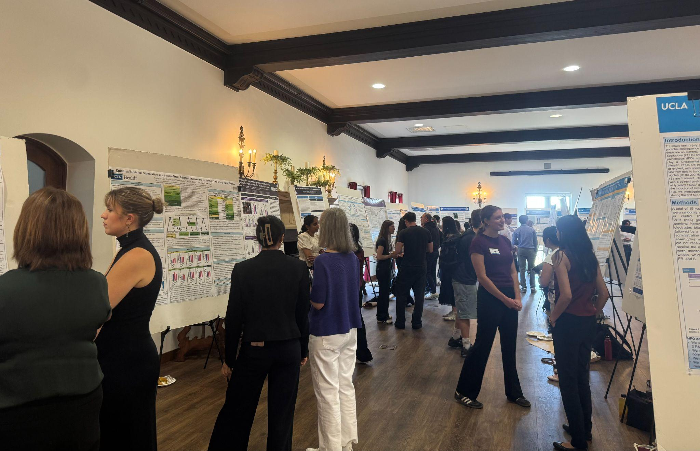
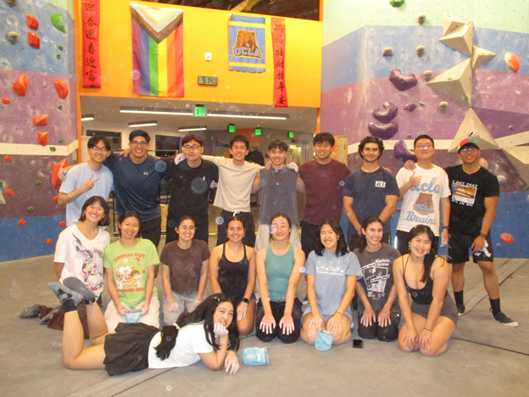
Integrative Biology & Physiology
Physiological Science (Phy Sci) Major
Notes:
From previous year:
“Are you interested in pursuing an education and career in medicine or one of the other health professions such as physical therapy, optometry, pharmacology, or dentistry among others, or perhaps industrial biotechnology or biomedical research is your passion? Are you interested in a career in one of the fields of public health or health science teaching? Or are you simply curious about how the human body functions and wonder where the educational preparation we offer can take you?
Physiological Science is the only major and academic discipline which provides an education that spans levels of biological organization from genes and gene networks, to molecular mechanisms of cell function, to cell and tissue organization and function, and to whole system level physiology.”

Slide 34
Physiological Science (Phy Sci) Major
What is the Phy Sci major?
Physiological Science spans levels of biological organization from genes and gene networks, to molecular mechanisms of cell function, to cell and tissue organization and function, and to whole system level physiology.
What do Phy Sci majors study?
Human anatomy and physiology
Disease mechanisms and therapies
Molecular systems biology
The microbiome in health and disease
Neurobiology
Musculoskeletal anatomy, physiology, and biomechanics
Animal physiology
Anatomy and physiology of sense organs

Slide 35
Physiological Science (Phy Sci) Major (Continued)
Major Highlights
Some courses provide the opportunity to work with human cadavers
Students may earn major credit for physiology-related research
Career Pathways
Medicine
Physical therapy
Dentistry
Biotechnology/biomedical research
Public health

Slide 36
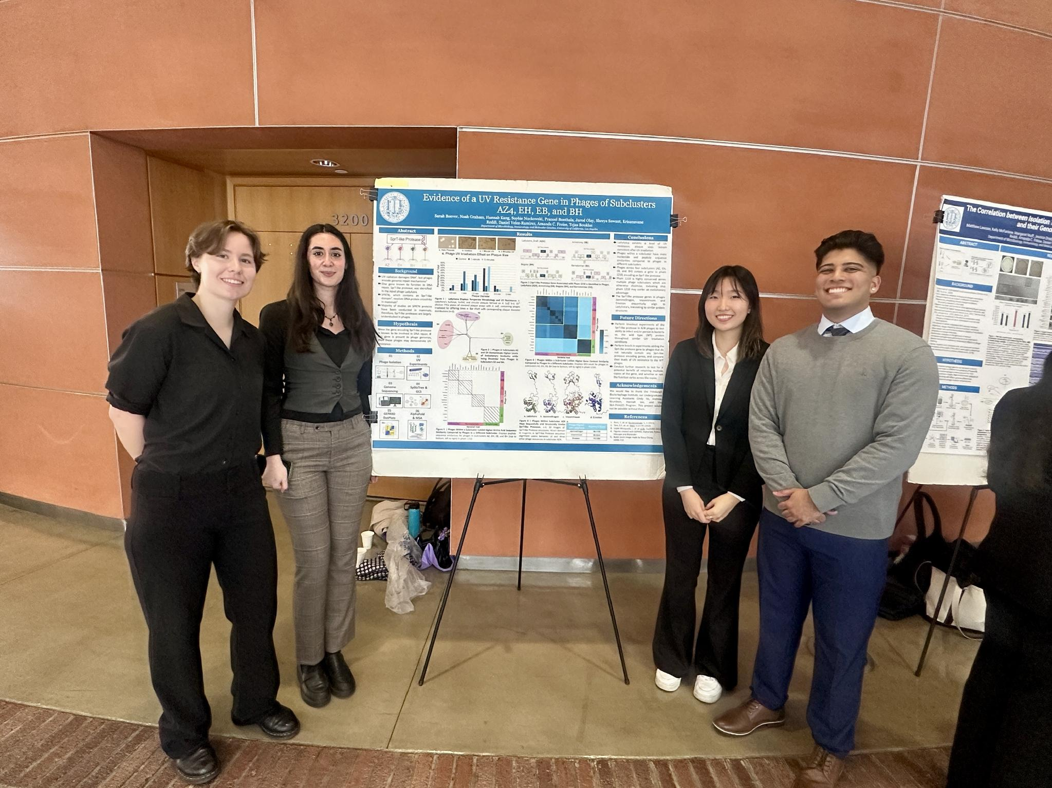
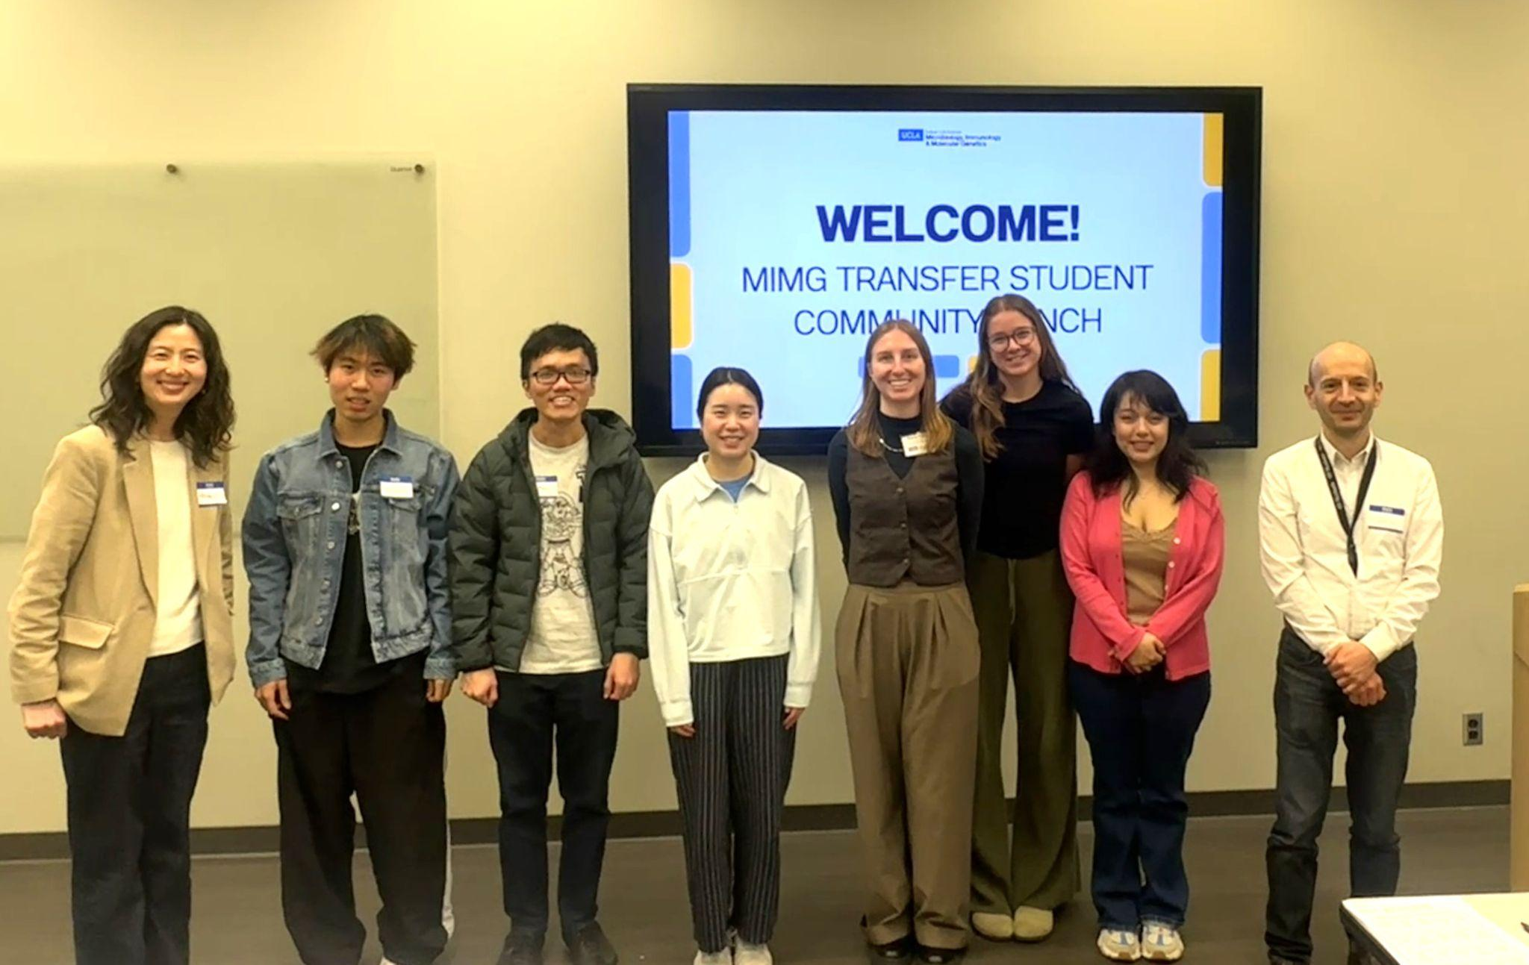
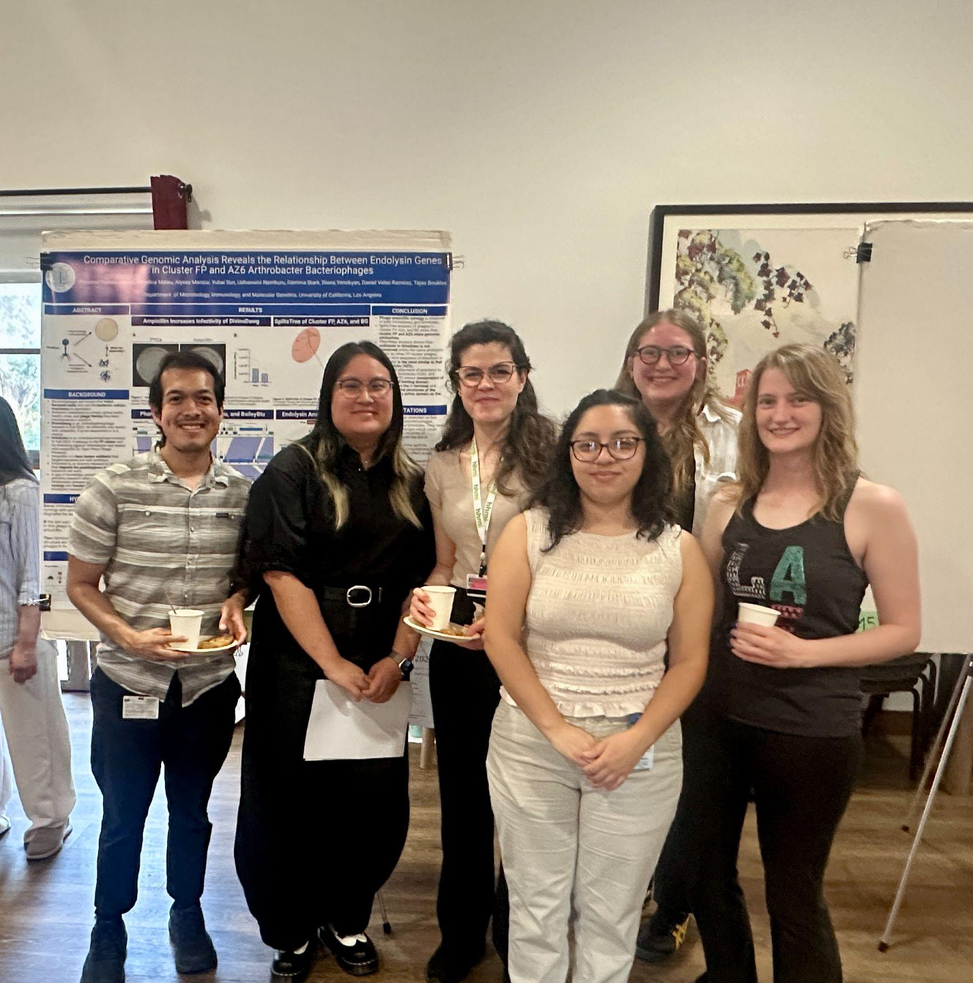
Microbiology, Immunology, and Molecular Genetics Department
MIMG Major

Slide 37
Microbiology, Immunology, and Molecular Genetics (MIMG) Major
What is the MIMG major / what will you study?
Explores microbes (bacteria, viruses, parasites) and how they affect human and environmental health
Studies the immune system and how it detects and fights infection (and even cancer)
Uses molecular genetics + molecular biology to explain what’s happening inside cells
Guaranteed, authentic research experience (two quarters) through course series
Big questions you’ll explore:
  How do infections start and spread?
  Why do some people get sicker than others?
  How do genes and immune responses shape health?
Notes:
The MIMG major combines cutting-edge biological science with hands-on research experience. Students engage in authentic research practices to develop and refine critical skills, preparing them to address pressing global challenges such as infectious diseases, cancer, climate change, & food security.

Slide 38
Microbiology, Immunology, and Molecular Genetics (MIMG) Major (Continued)
As an MIMG major, you will:
Build a strong science foundation that connects biology, chemistry, physics, and quantitative thinking
Develop core scientist skills:
  Reading and discussing scientific papers
  Designing experiments and asking testable questions
  Analyzing data and interpreting results
  Communicating findings in writing and presentations
Get hands-on research experience (a major highlight):
  Guaranteed authentic research through Path 1 research-immersion courses (2 quarters required)
  Take lab-based courses and present at an undergraduate research symposium

Slide 39
MIMG (Continued)
Major Highlights and where MIMG can lead you
Why students choose MIMG:
Training that’s directly relevant to today’s biggest challenges: infectious diseases, cancer, climate change, and food security
Research experience with award-winning faculty and opportunities to publish in academic journals as an undergraduate
Departmental Honors Program option for research students who want to develop a focused project and write a thesis at UCLA
Pathways after MIMG:
  Career fields: biomedical research, biotech, public health, environmental science, science policy/bioethics
  Common next steps: graduate school or health professions (e.g., medicine, dentistry)

Slide 40
Molecular, Cell &
Developmental Biology (MCDB)
MCDB Major

Slide 41

Molecular, Cell & Developmental Biology (MCDB) Major
What is MCDB?
The study of life on earth at cellular and molecular levels.
What do MCDB majors study at UCLA?
Molecular processes involved in cell function and differentiation.
Molecular processes at the single and the multicellular level, as well as the role of genes in multicellular organisms.
How to use the scientific method to test questions and solve problems using quantitative and inquiry-related skills.
Major Highlights
Courses taught with primary literature
Opportunities to participate in cutting-edge, discovery-based research

Slide 42
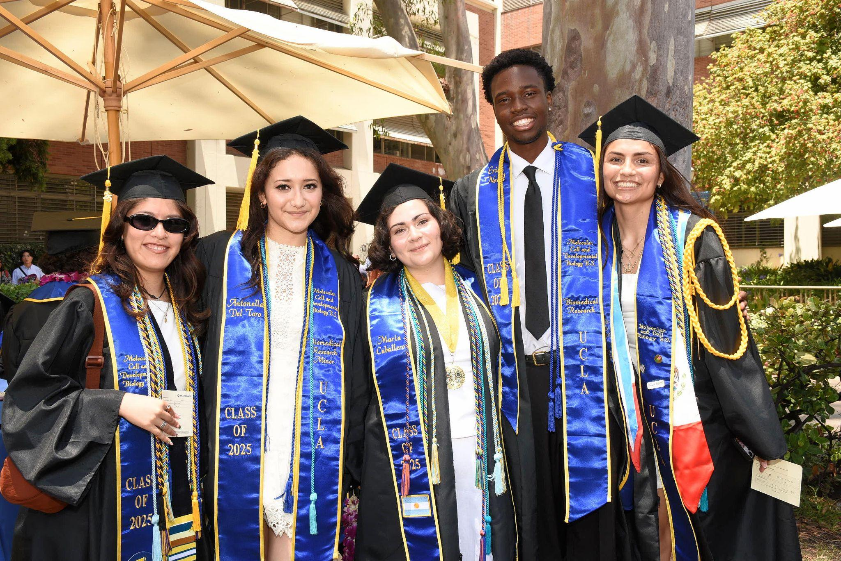
MCDB (Continued)
What kind of classes do MCDB majors take?
Biochemistry
Genetics
Molecular Biology
Cell Biology
Developmental Biology
Discovery-based lab classes
Electives from across the Life Sciences
Career Paths / Next Steps
Medical school (or other health professional school)
Graduate school
Laboratory research
Academia
Genetic Counseling
Biotech

Slide 43
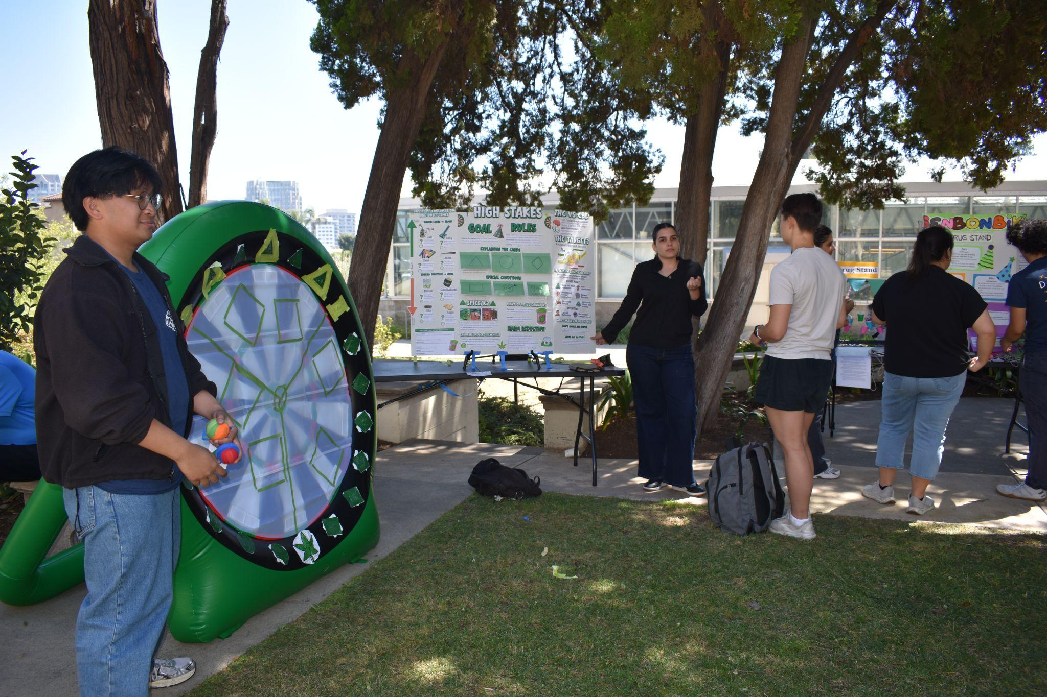
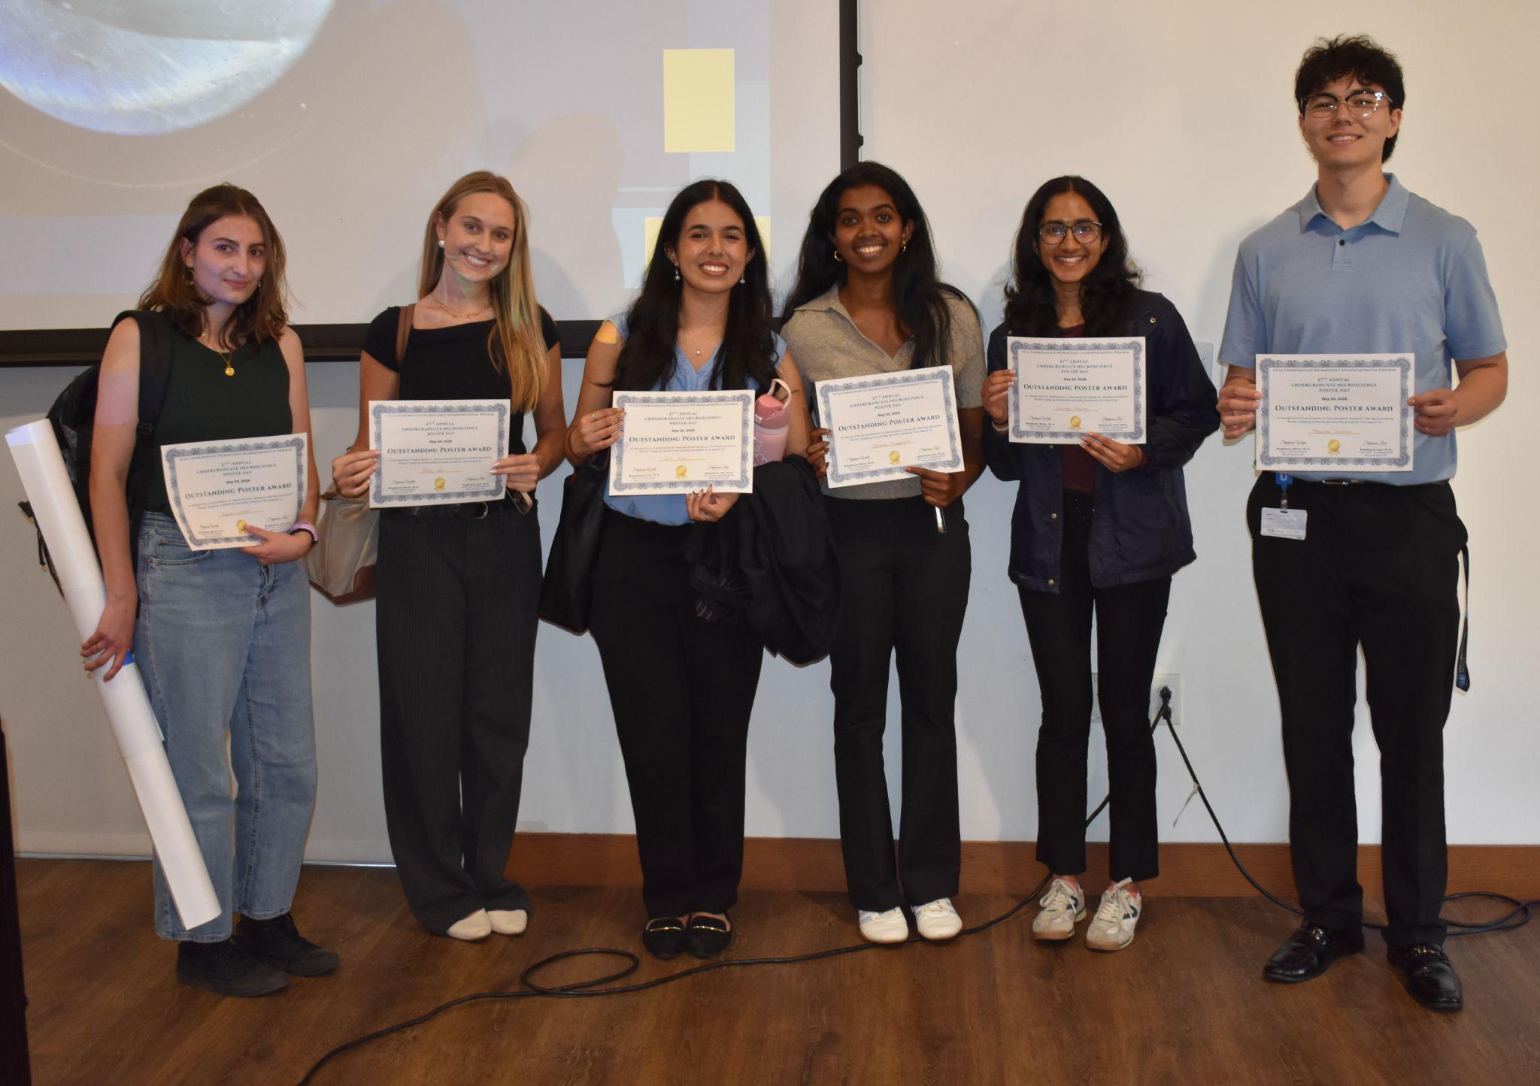
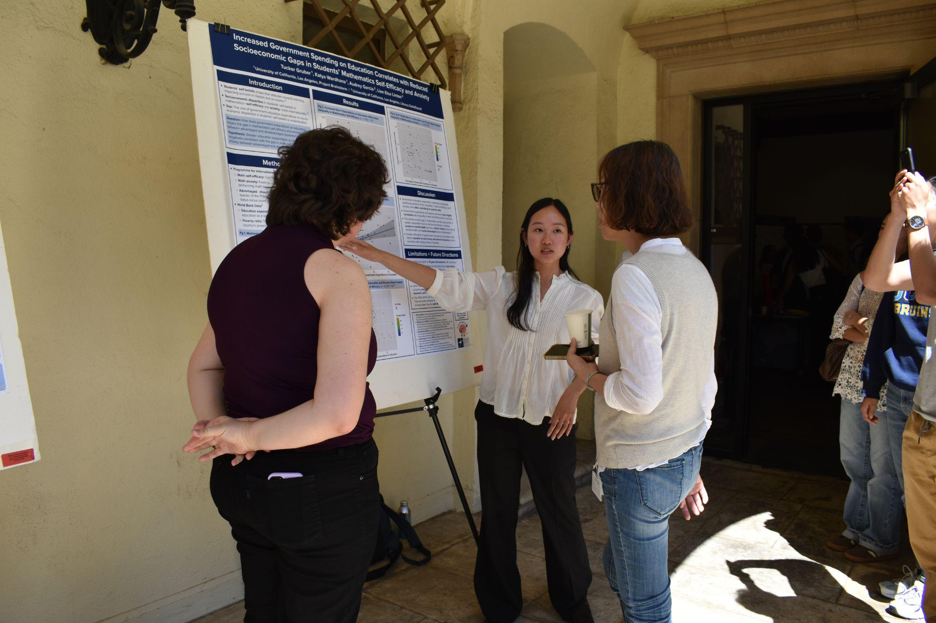
Neuroscience Interdepartmental Program
Neuroscience Major

Slide 44
Neuroscience Major
What is Neuroscience?
Neuroscience is the scientific study of the brain and nervous system, whose ultimate goal is to understand higher brain function at a variety of levels
What do Neuroscience majors study?
Nervous system structure and function across multiple levels, from molecules and cells to circuits, behavior, and cognition
Neural bases of perception, emotion, learning, memory, and decision-making
Nervous system development and plasticity over time
Biological foundations of neurological and psychiatric disorders
Scientific research methods used to study the brain, including experiments, analysis, and modern tools
Major Highlights
Interdisciplinary curriculum with exposure to faculty from several departments in the College and medical school

Slide 45
Neuroscience Major
Major Highlights (Cont.)
Capstone major – various options to engage in hands-on experiential learning, including faculty-mentored independent research and K-12 educational outreach
Career Pathways
Medicine and health professions
Research and academia
Biotechnology and healthcare industry
Technology and data-related careers
Consulting and business
Education and outreach

Slide 46
Biomedical Research Minor
Biomedical Research Minor

Slide 47
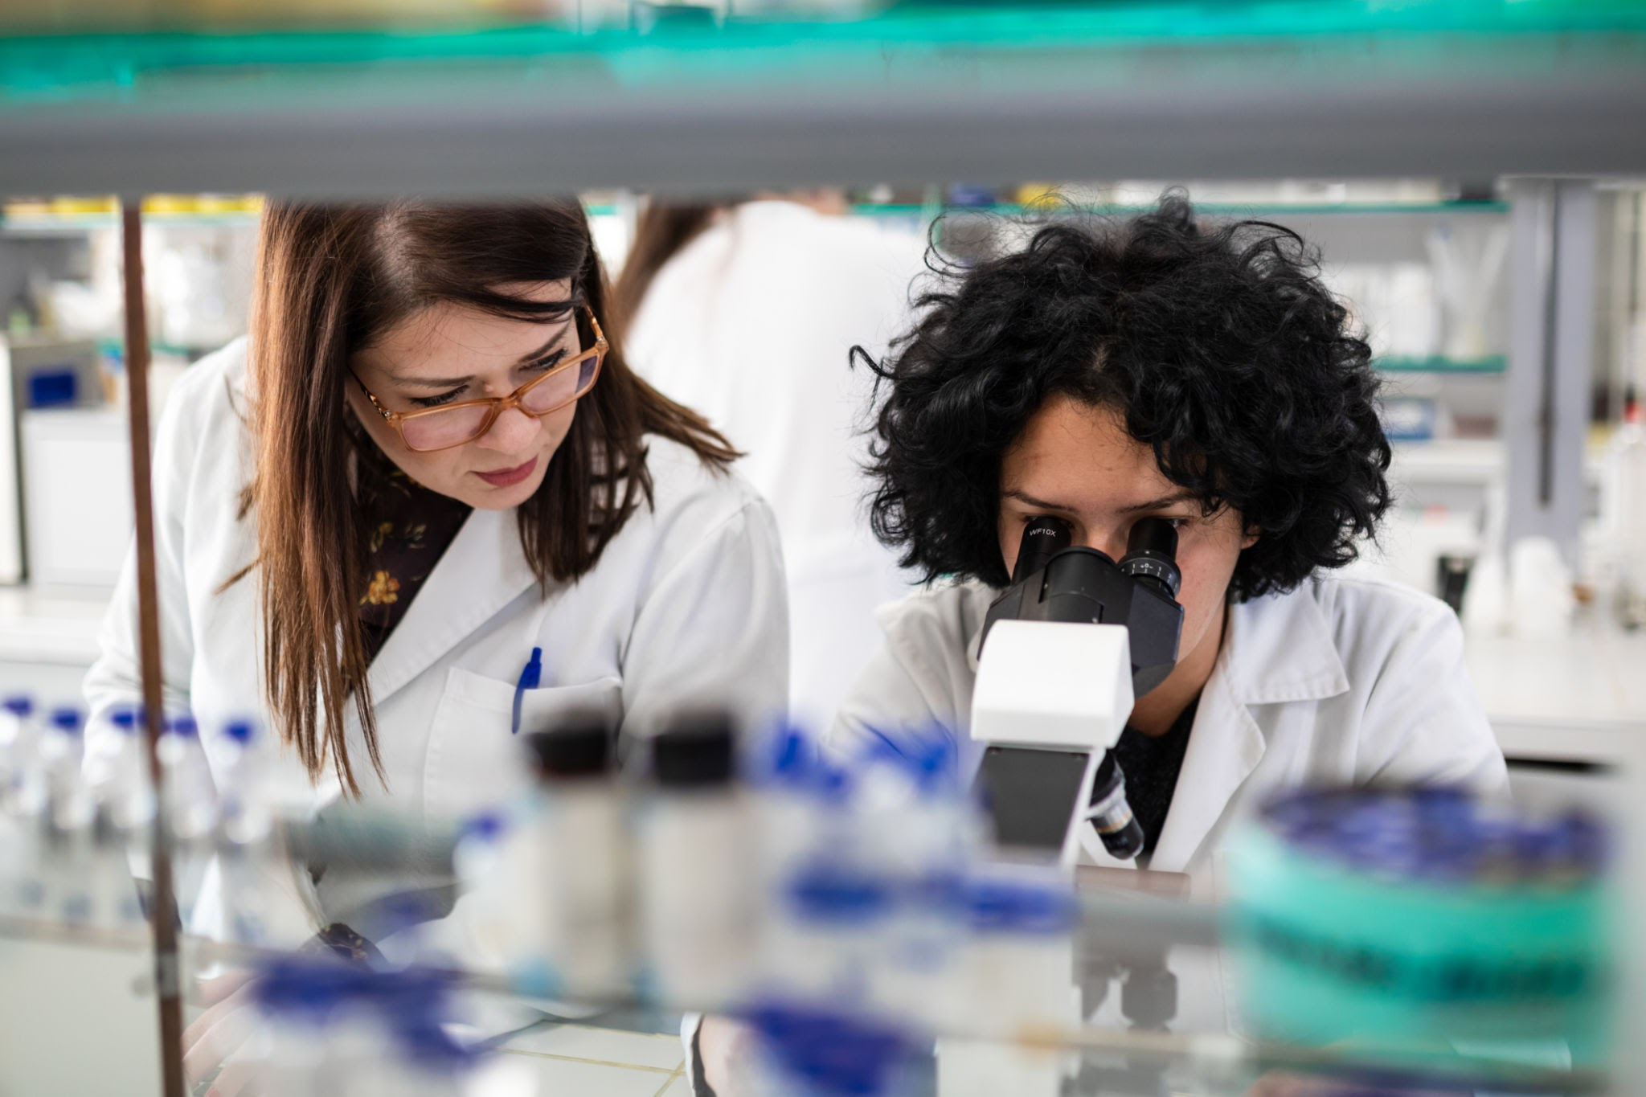
Biomedical Research Minor
Applying to the Minor
Students from any major can join the Minor
Minimum 3.0 GPA
Take 1 Introductory course
Application open every week 4 and close week 7 of Fall, Winter, Spring
Can apply until Fall quarter of the third year (Winter for transfer students)
Next Steps/Career Paths:
Medical or Pharmacy school (or other health professional school)
Graduate school
Laboratory research
Academia
What is Biomedical Research Minor?
Interdepartmental minor that is designed to involve students in laboratory research early in their college career.
Minor Highlights
Training as a research scientist
Informed lab placement
Undergraduate research community
Integration of social sciences and humanities
Courses in biomedical research skills & concepts, ethics, journal club & data presentation seminars
Complete a thesis and research presentation
80% of alumni continue on to pursue graduate school

Slide 48
Life Science Major & Career Exploration

Slide 49
Life Science Majors at UCLA
Biology B.S.)
Cognitive Science B.S.
Computational Biology B.S.
Ecology, Behavior and Evolution B.S..
Human Biology and Society B.A., B.S.
Physiological Science B.S.
Marine Biology B.S.
Microbiology, Immunology & Molecular Genetics B.S.
Molecular, Cell and Developmental Biology B.S.
Neuroscience B.S
Psychobiology B.S.
Psychology B.A.

Slide 50
Life Science Minors at UCLA
Applied Developmental Psychology
Biomedical Research Minor (Application Required)
Brain and Behavioral Health
Conservation Biology
Environmental Systems and Society
Evolutionary Medicine
Mathematical Biology
Neuroscience
Science Education
Society and Genetics
Structural Biology
Systems Biology

Slide 51
Switching Your Major During Orientation
First-Year Admitted Students in the College of Letters and Sciences (i.e. MIMG majors and Life Sciences majors) are permitted to switch their major within the College of Letters of Sciences during UCLA New Student Orientation prior to enrolling in Fall 2026 courses.
Students' New Student Advisors will guide this process.

Slide 52
Switching Your Major Beginning Fall Quarter
First-year admitted students should please connect with UCLA College Advisors in addition to the respective UCLA Major Departmental Advisors to inquire about switching majors.
Each UCLA Life Science Major will have a different requirements for major entry, and some programs will require applications.

Slide 53
LIFESCI 110: Career Exploration in the Life Sciences
2 units (upper-division)
Option for Winter or Spring quarters
Reasons to take the course:
  If unsure of career path or options outside of medical school or academica
  Wanting to prepare for internship or job market
Learning experiences:
  Build resume and cover letter
  Alumni guest speakers
  Practice interviewing skills
  Engage in career self-assessments/reflections

Slide 54
Fall 2026 Enrollment Recommendations

Slide 55
Fall ‘26 Enrollment Recommendations
3 Courses Total (12+ units = full-time courseload)
2 Life Sciences Core/ Major Prep. Requirements:
Any combination of Calculus (i.e. LIFESCI 30A), Life Sciences (LIFESCI 7A), and/or Chemistry (i.e. CHEM 14A).
Examples:
      LIFESCI 30A (5 units) & LIFESCI 7A (5 units)
      LIFESCI 30A (5 units) & CHEM 14A (4 units)
1 College Requirement (Non-Major Course)
Examples: Cluster, ENG COMP 3 course, UCLA G.E. course as recommended by UCLA New Student Advisor.

Slide 56
What to Expect for Fall ‘26 Enrollment:
New Student Advisors (NSAs) can support with timely guidance during your orientation enrollment time.
NSAs have training about Life Science requirements and have a copy of your major preparation course recommendations for this Fall quarter.

Slide 57
Resources

Slide 58
Resources
UCLA Departmental Advising Contact List
Enrollment Resources
Pre-Health Resources
Undergraduate Research Resources
UCLA Tutoring Resources

Slide 59
Thank you!
Any questions?

